Slide 1
Shell Bootcamp 2024 3 Reflections for Week 2
Sakshi Sharma
Date : 30-Aug-2024

Slide 2

About Me
Do the best you can, with what you have.

Slide 3

My learnings from this week!

Slide 4
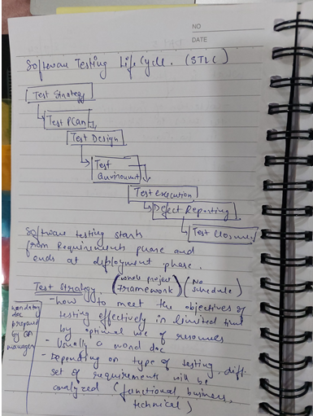
Learning 1 | My takeaways
Software Testing Life cycle (STLC)
STLC ensures software quality through systematic testing. Each stage in STLC helps ensure that the software meets the required standards and functions correctly.
Effective software testing is crucial for identifying and fixing defects early in the development process, which reduces overall costs and ensures a high-quality product.
I think that STLC plays a vital role in ensuring the reliability and efficiency of digital systems in the energy sector.

Slide 5
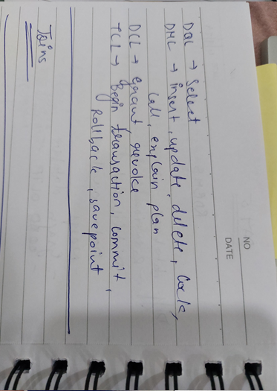
Learning 2 | My takeaways
Relational Database Management System
RDBMS allows for efficient data retrieval, manipulation, and management through the use of SQL.
They are essential for managing large volumes of data efficiently as they provide a robust framework for data storage, retrieval, and manipulation.
In the energy sector, RDBMSs can be used to manage vast amounts of data generated by various sources such as smart meters, IoT devices, and energy management systems.

Slide 6
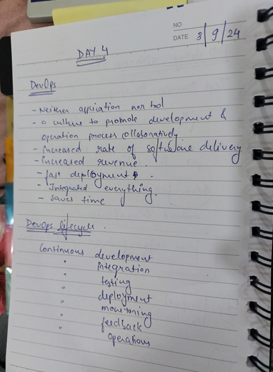
Learning 3 | My takeaways
DevOps and Cloud
Together, DevOps and cloud computing enhance collaboration, automation, and scalability in software development.
Integrating DevOps with cloud computing allows organizations to accelerate their development processes, improve collaboration between teams.
In the energy sector, cloud platforms can be used to automate processes and additionally, DevOps practices enable continuous monitoring and rapid deployment, ensuring that energy systems remain reliable efficient.

Slide 7

Relevance of learnings for my organization

Slide 8
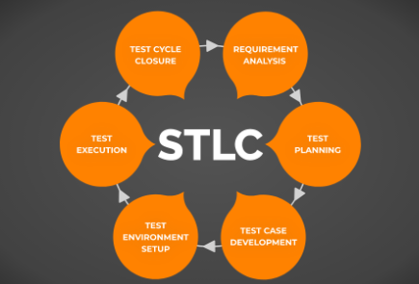
Learning 1 | Relevance for Shell
Shell implements STLC by rigorously testing software used in smart grids and renewable energy systems. This helps prevent disruptions and enhances the efficiency of energy distribution.
By implementing STLC, Shell can identify and fix defects early, reducing downtime and maintenance costs. This ensures the reliability of critical systems like smart grids and renewable energy platforms, leading to uninterrupted energy supply and improved customer satisfaction.

Slide 9
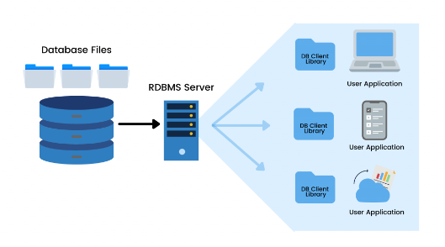
Learning 2 | Relevance for Shell
Shell uses RDBMS to manage data from smart meters, IoT devices, and energy management systems. They ensure data integrity and security, enabling real-time monitoring and analysis.
Using RDBMS, Shell can efficiently manage and analyze large volumes of data from various sources.

Slide 10
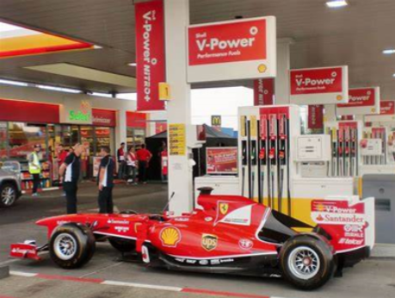
Learning 3 | Relevance for Shell
Shell adopts DevOps and cloud computing to automate processes and enhance collaboration. It uses cloud platforms for scalable resource management and predictive maintenance.
Adopting DevOps and cloud computing allows Shell to automate processes, leading to faster and more reliable software deployments.

Slide 11

Challenges in implementing learning

Slide 12
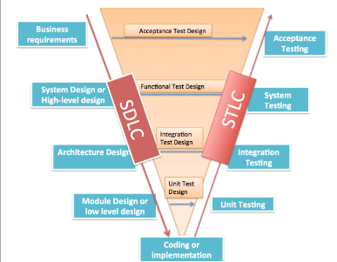
Challenge faced while implementing Learning 1
While implementing STLC, one of the challenges I faced was incomplete requirements. It became difficult to design effective test cases, leading to missed defects and inadequate test coverage.
I plan to overcome this by Actively participating in requirement gathering and analysis sessions to clarify any doubts.

Slide 13
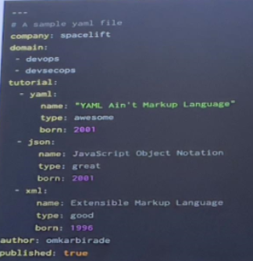
Challenge faced while implementing Learning 2
One of the challenges I faced while implementing RDBMS was scalability. As the volume of data grows, maintaining performance and efficiency can become difficult.
I plan to overcome this by regularly reviewing and optimizing SQL queries to ensure they run efficiently.

Slide 14
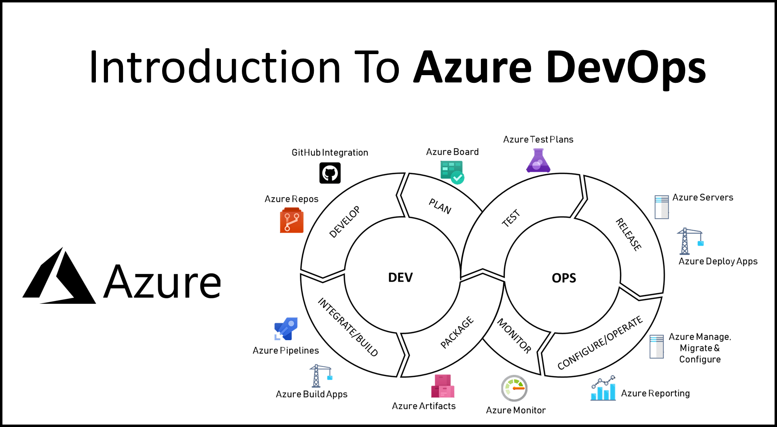
Challenge faced while implementing Learning 3
One of the challenges I faced while implementing Azure DevOps was integration with existing tools and systems.
I plan to overcome this by implementing Azure DevOps in phases, starting with less critical systems to minimize disruption and gradually expanding its use.

Slide 15

Action Plan

Slide 16
My Action Plan for this Week
Actions
Timeline
Status
Interacting with my peers and team members.
Setting up GTKYs with Shell employees and learning from their experience.
I plan to implement these actions right away and aim to build a good network in Shell within the next 2 to 3 months.
Met a few members from my Line of Business including my line manager and Buddy.

Slide 17

Learning is also Fun!

Slide 18
Learning is also Fun!
Our facilitator conducted the sessions in a fun manner while at the same time educating us.
We did a couple of activities to understand Business Analysis and Agile.
To understand importance of Requirement Analysis for a project, we made paper planes.
[Add a graphic or a picture of how you/your team enjoyed the new learning]

Slide 19
Thank You

